Slide 1

Time Series Analysis

Slide 2
Agenda
In this session, you will learn about:
Introduction to Forecasting
Introduction to Time Series
Concepts of Forecasting
Time Series Models

Slide 3

Introduction to Forecasting

Slide 4
What is Forecasting?
Forecasting is to predict or estimate a future event or trend
For businesses and analysts forecasting is determining what is going to happen in the future by analyzing what happened in the past and what is going on now
Good forecasts capture the genuine patterns and relationships which exist in the historical data, but do not replicate past events that will not occur again

Slide 5
Approaches to Forecasting
Common approaches to forecasting
Qualitative forecasting
Quantitative forecasting
Used when historical data are unavailable
Considered highly subjective and judgmental
Use past data to predict future values

Slide 6
Types of Quantitative Forecasting
Straight-Line Method: A financial analyst uses historical figures and trends to predict future revenue growth
Moving Average: Moving averages is a smoothing technique that looks at the underlying pattern of a set of data to establish an estimate of future values
Simple Linear Regression: Regression analysis is a widely used tool for analyzing the relationship between variables for prediction purposes
Multiple Linear Regression: Multiple linear regression is used to forecast when two or more independent variables are required for a projection.

Slide 7
Introduction to Time Series

Slide 8
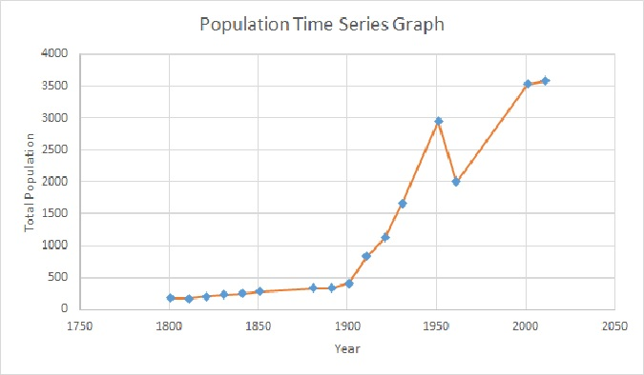
Time Series
A time series is a collection of data points against various time periods
Time series can be found virtually everywhere
For example:
Sales data of a Company
Monthly inflation number (i.e. CPI / WPI) as released by MOSPI
World population over years
Stock Prices

Slide 9
Time Series Data
Time Series data is numerical data obtained at regular time intervals
The time intervals can be annually, quarterly, monthly, weekly, daily, hourly
Year: 2000 2001 2002 2003 2004
Sales: 75.3 74.2 78.5 79.7 80.2
Time series data is further classified into :
Univariate
Multivariate

Slide 10
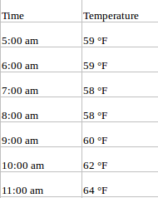
Univariate Time Series
A univariate time series is a series with a single time-dependent variable
For example, the dataset consists of the temperature values (each hour). Here, temperature is the dependent variable (dependent on Time)
Although a univariate time series data set is usually given as a single column of numbers, time is in fact an implicit variable in the time series

Slide 11
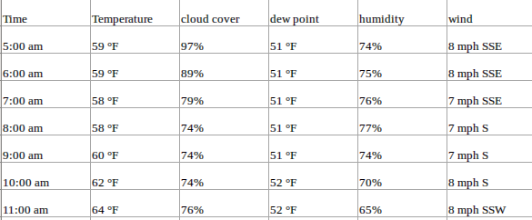
Multivariate Time Series
A Multivariate time series has more than one time-dependent variable
Each variable depends not only on its past values but also has some dependency on other variables
This dependency is used for forecasting future values
Our dataset includes perspiration percent, dew point, wind speed, cloud cover percentage along with the temperature
In this case, there are multiple variables to be considered to optimally predict temperature

Slide 12
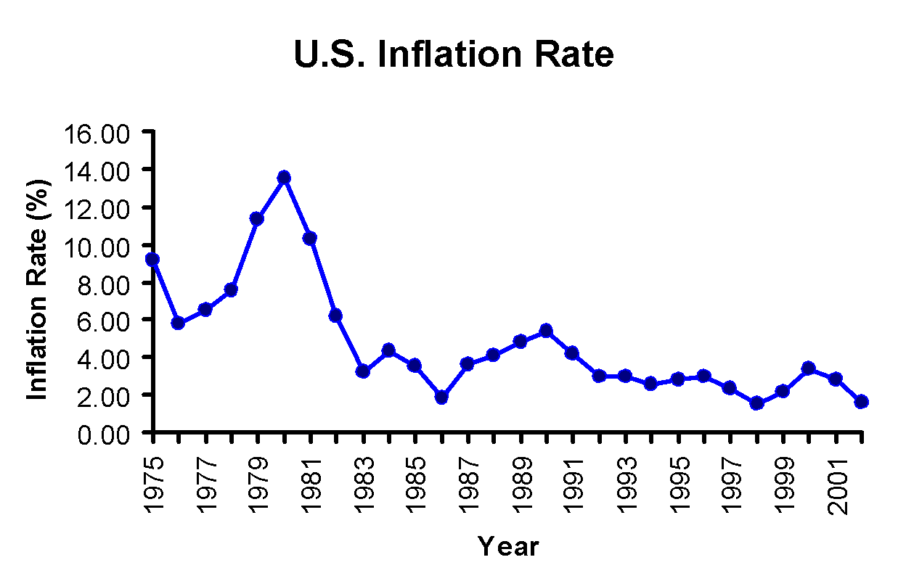
Time Series Plot
A time-series plot is a two-dimensional plot of time series data
The vertical axis measures the variable of interest
The horizontal axis corresponds to the time periods

Slide 13
Components of Time Series
Time Series
Trend Component
Seasonal Component
Cyclical Component
Irregular Component

Slide 14
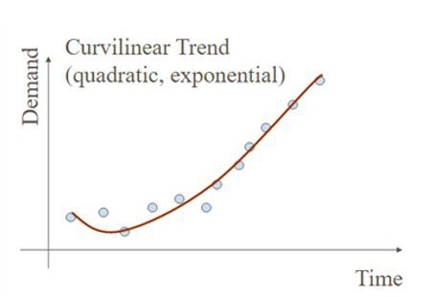
Trend Component
Long-run increase or decrease over time (overall upward or downward movement)
Data taken over a long period of time
Trend can be upward or downward
Trend can be linear or nonlinear

Slide 15
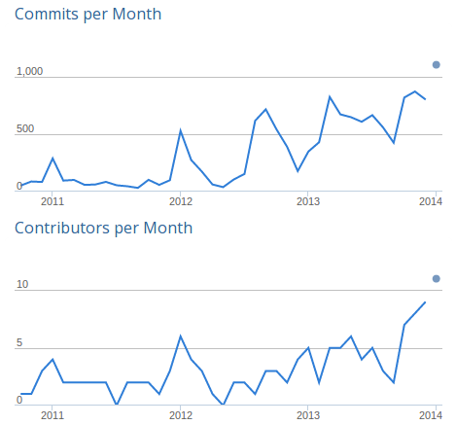
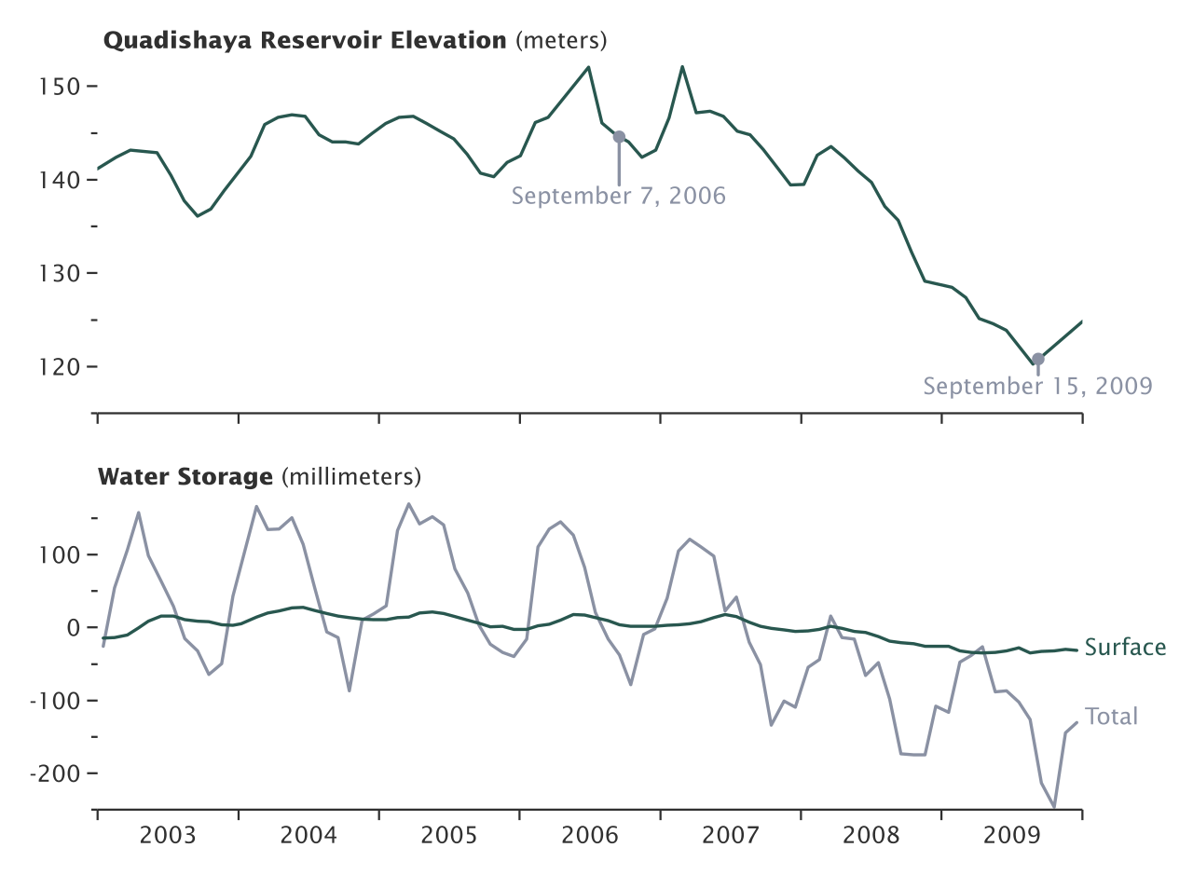
Trend Component
Upward Trend
Downward Trend

Slide 16
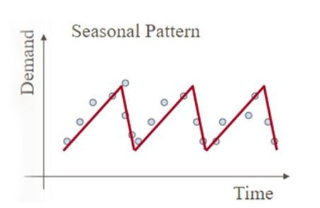
Seasonal Component
Short-term regular wave-like patterns
Observed within 1 year
Often monthly or quarterly

Slide 17
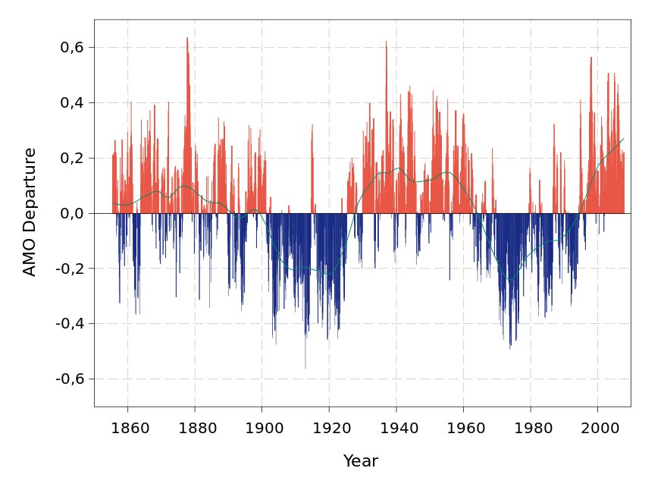
Cyclical Component
Long-term wave-like patterns
Regularly occur but may vary in length
Often measured peak to peak or trough to trough

Slide 18
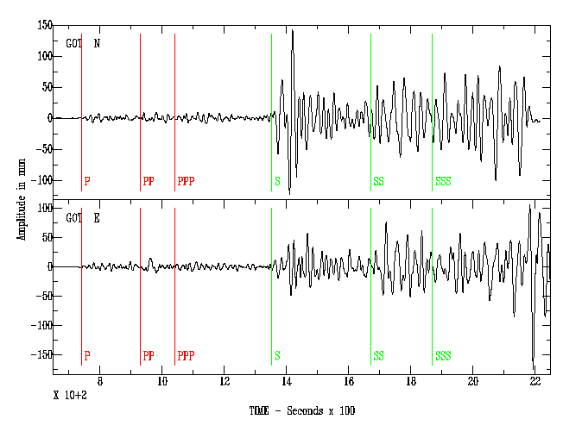
Irregular Component
Unpredictable, random, “residual” fluctuations
Due to random variations of
Nature
Accidents or unusual events
“Noise” in the time series

Slide 19
Stationarity
The statistical properties of a process generating a time series do not change over time
It does not mean that the series does not change over time, just that the way it changes does not itself change over time
The algebraic equivalent is thus a linear function and not a constant one
The value of a linear function changes as 𝒙 grows, but the way it changes remains constant that is it has a constant slope
A constant slope is one value that captures that rate of change.

Slide 20
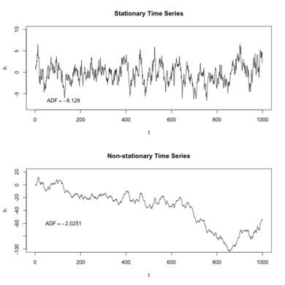
Stationarity
Stationary Time Series
Non-Stationary Time Series

Slide 21
Conditions of Stationarity
Constant Mean
Constant Variance
Autocovariance does not depend on time
Reasons behind the non-stationarity of time series
Trend in series
Seasonality of time series

Slide 22
Test to check Stationarity
Rolling Statistics:
Plot the moving average or variance and see if it varies with time
ADF Test (Augmented Dickey–Fuller Test):
Null hypothesis is that the time series is non-stationary. The test results comprise of a test statistics and some critical values

Slide 23
Methods to make series Stationary
De-trending: It includes regressing against covariates other than time
Seasonal adjustment: It takes differences but could be construed as a separate technique
Transformation of the data: It implicitly converts a difference operator into something else; e.g., differences of the logarithms are actually ratios
Some EDA smoothing techniques (such as removing a moving median) could be construed as non-parametric ways of detrending

Slide 24
Smoothing
Smoothing techniques are kinds of data preprocessing techniques to remove noise from a data set
This allows important patterns to stand out
The idea behind data smoothing is that it can identify simplified changes to help predict different trends and patterns
It acts as an aid for statisticians or traders who need to look at a lot of data.

Slide 25
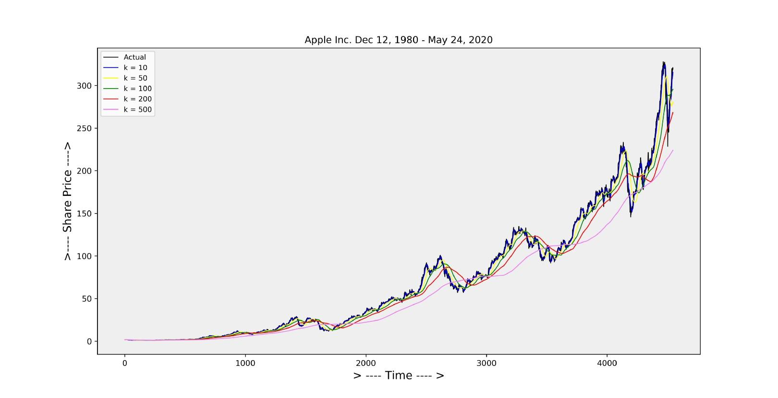
Moving Average Smoothing (MAS)
In MAS time series derived from the average of last kth elements of the series
Smaller values of k lead to more variation in the result
Larger value of k leads to more smoothness.

Slide 26

Steps in Moving Average Smoothing
Calculate moving averages to get an overall impression of the pattern of movement over time
Averages of consecutive time series values for a chosen period of length L

Slide 27
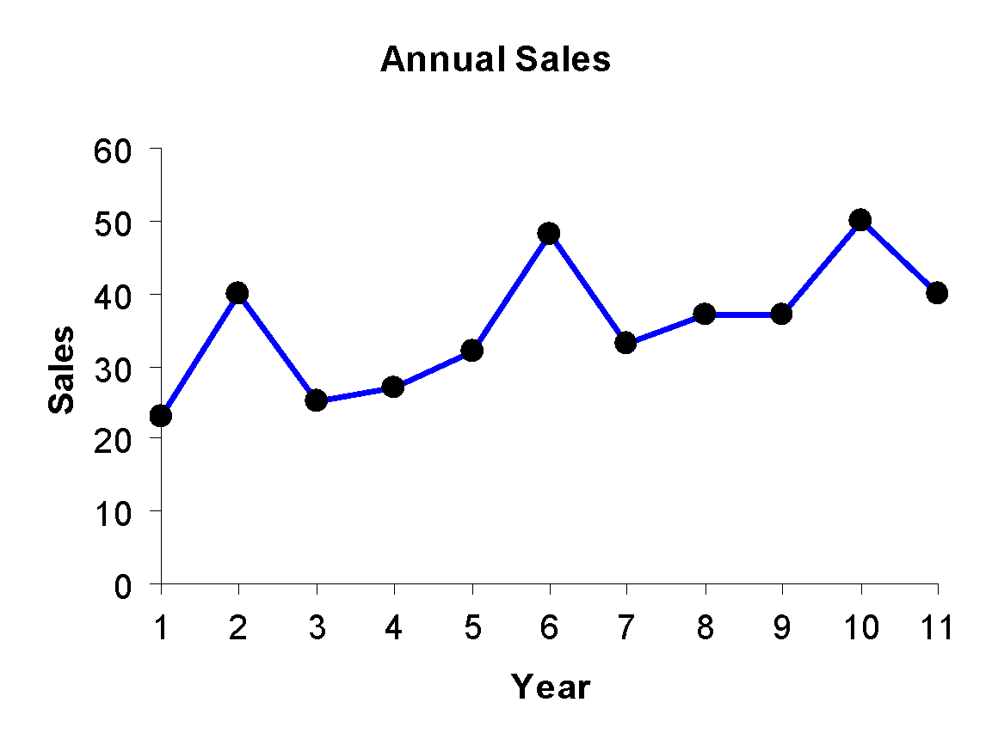
Steps in Moving Average Smoothing (cont..)
Example: Annual Data
Year | Sales
1 2 3 4 5 6 7 8 9 10 11 etc... | 23 40 25 27 32 48 33 37 37 50 40 etc...

Slide 28
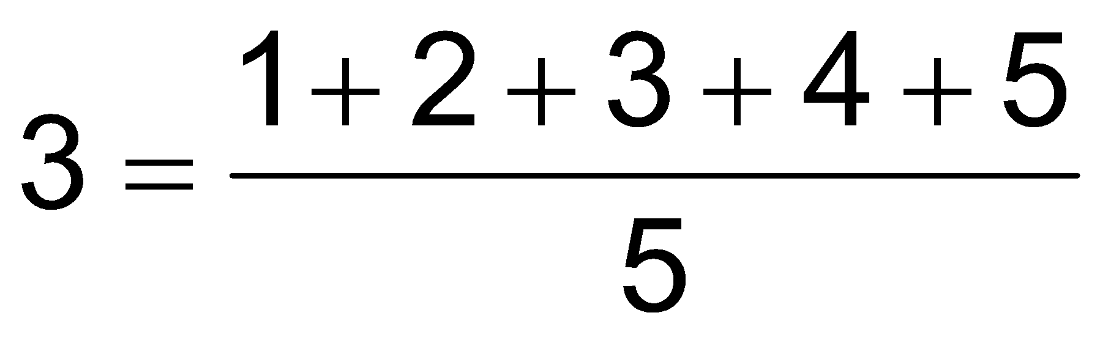
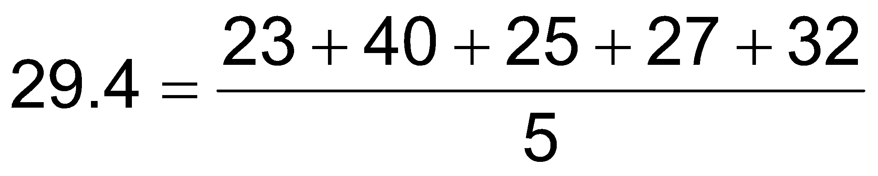
Steps in Moving Average Smoothing (cont..)
Calculating Moving Averages
Year | Sales
1 | 23
2 | 40
3 | 25
4 | 27
5 | 32
6 | 48
7 | 33
8 | 37
9 | 37
10 | 50
11 | 40
Average Year | 5-Year Moving Average
3 | 29.4
4 | 34.4
5 | 33.0
6 | 35.4
7 | 37.4
8 | 41.0
9 | 39.4
… | …

Slide 29
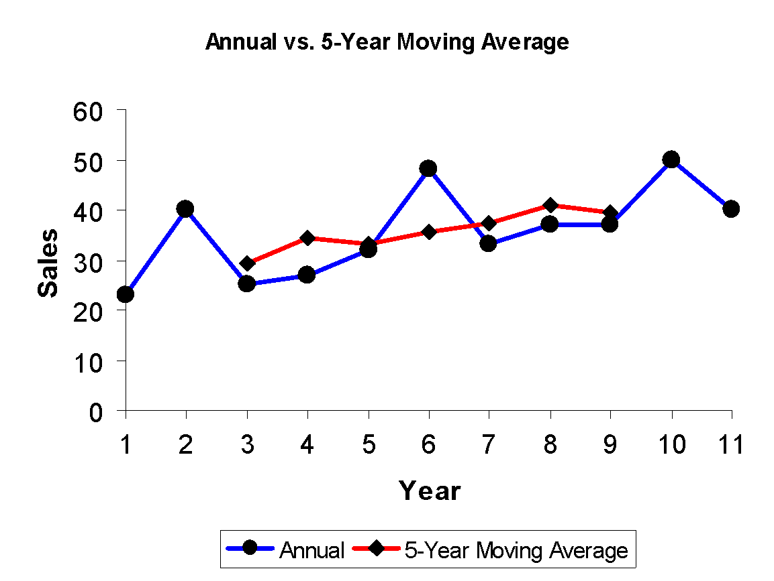
Steps in Moving Average Smoothing (cont..)
The 5-year moving average smoothes the data and makes it easier to see the underlying trend

Slide 30
Drawbacks of Moving Average
The main problem is to determine the extent of the moving average which completely eliminates the oscillatory fluctuations.
This method assumes that the trend is linear but it is not always the case.
It does not provide the trend values for all the terms.
This method cannot be used for forecasting future trend which is the main objective of the time series analysis.

Slide 31
Exponential Smoothing
Exponential smoothing is generally used to make short term forecasts but longer term forecasts using this technique can be quite unreliable.
More recent observations given larger weights by Exponential smoothing methods
The weights decrease exponentially as the observations become more distant.
When the parameters describing the time series are changing slowly over time then these methods are most effective.

Slide 32
Types of Exponential Smoothing
Simple Exponential Smoothing
Double Exponential Smoothing
Triple Exponential Smoothing

Slide 33
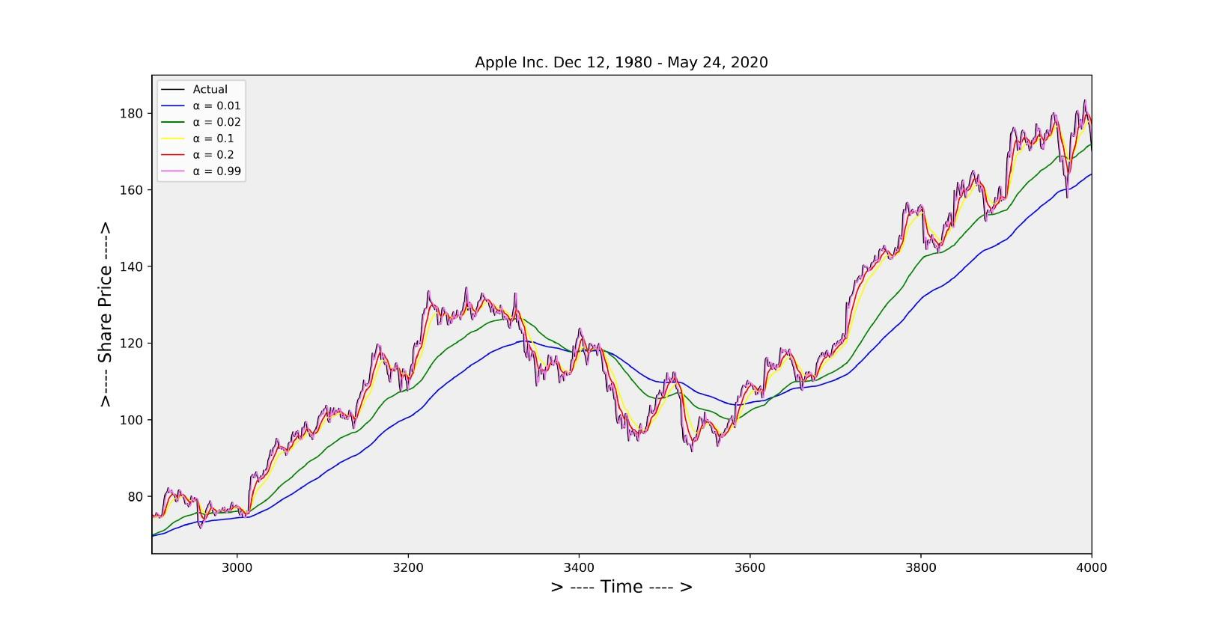
Simple Exponential Smoothing (SES)
SES is a time series forecasting method for univariate data without a trend or seasonality
In the moving average smoothing the past observations are weighted equally
In this case exponentially decreasing weights are assigned to the past observations

Slide 34
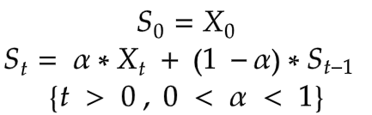
Equation of Simple Exponential Smoothing
(1−α) is multiplied by the previously expected value St-1 which is derived using the same formula
This makes the expression recursive and makes the method exponential

Slide 35
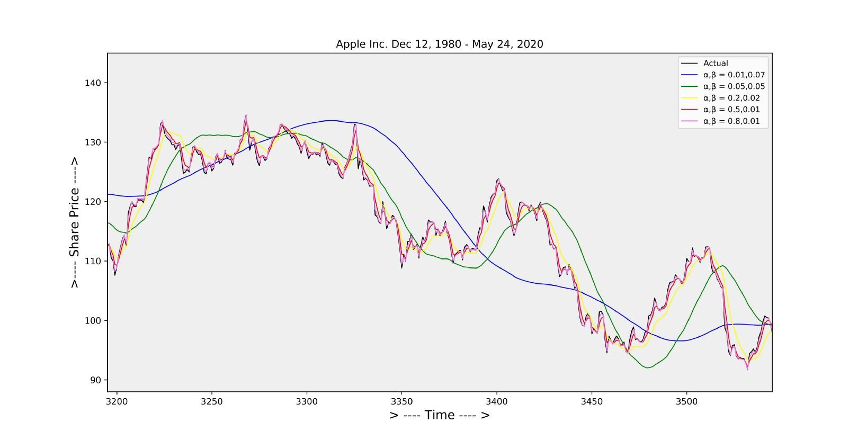
Double Exponential Smoothing (DES)
DES is used for forecasting the time series when the data has linear trend and no seasonal pattern
It is also called as Holt’s trend corrected or second order exponential smoothing
It take into account the possibility of a series showing some form of trend
This slope component is itself updated through exponential smoothing

Slide 36
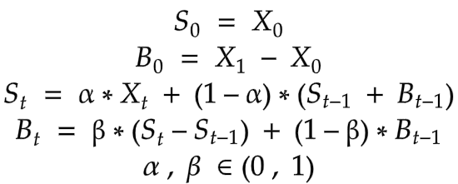
Equation of Double Exponential Smoothing
St = smoothed statistic, it is the simple weighted average of current observation Xt
St-1 = previous smoothed statistic
α = smoothing factor of data; 0 < α < 1
t = time period
Bt = best estimate of trend at time t
β = trend smoothing factor; 0 < β <1
S1 = x1 , B1 = x1-x0

Slide 37
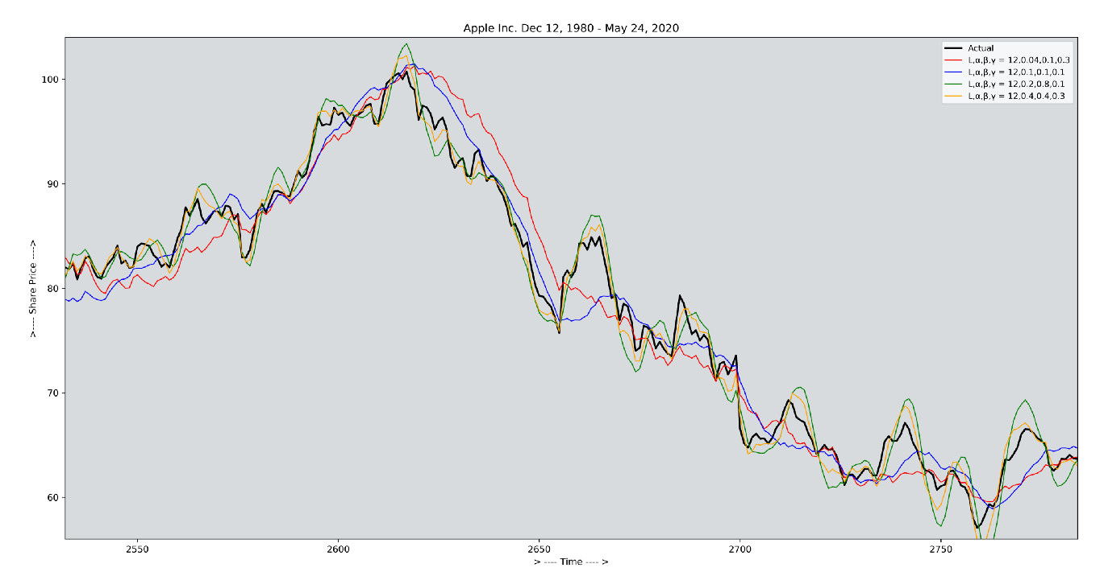
Triple Exponential Smoothing (TES)
TES is used for forecasting the time series when the data has both linear trend and seasonal pattern
It is also called as Holt-winters exponential smoothing
In addition to the alpha and beta smoothing factors, a new parameter is added called gamma (g)
It controls the influence on the seasonal component

Slide 38
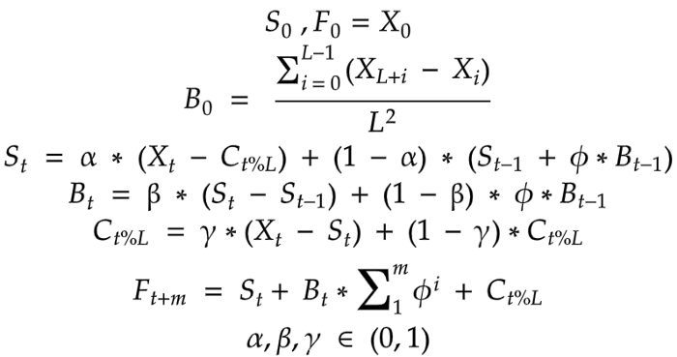
Equation of Triple Exponential Smoothing
St = simple weighted average of current observation Xt
St-1 = previous smoothed statistic
α = smoothing factor of data; 0 < α < 1
t = time period
Bt = best estimate of trend at time t
β = trend smoothing factor; 0 < β <1
ct = sequence of seasonal correction factor at time t
γ = seasonal change smoothing factor; 0 < γ < 1

Slide 39
Conditions of Exponential Smoothing
The weight (smoothing coefficient) is α
Subjectively chosen
Ranges from 0 to 1
Smaller W gives more smoothing, larger W gives less smoothing
The weight is:
Close to 0 for smoothing out unwanted cyclical and irregular components
Close to 1 for forecasting

Slide 40
Conditions of Exponential Smoothing
The sales of a magazine in a stall for the previous 10 months is given below.
Month | Sales
January | 30
February | 25
March | 35
April | 25
May | 20
June | 30
July | 35
August | 40
September | 30
October | 45

Slide 41
Conditions of Exponential Smoothing
Month | Sales | Exponential smooth
January | 30 | 30
February | 25 | 30
March | 35 | 28.5
April | 25 | 30.45
May | 20 | 14.1
June | 30 | 15.87
July | 35 | 20.109
August | 40 | 24.5763
September | 30 | 29.20341
October | 45 | 29.442387
November | - | 34.1096709
After calculating the simple exponential smoothing
By taking α =0.3 for the above data

Slide 42
How to configure Exponential Smoothing
All of the model hyperparameters can be specified explicitly
It is common to use numerical optimization to search for and fund the smoothing coefficients (alpha, beta, gamma, and phi) for the model that result in the lowest error
The parameters that specify the type of change in the trend and seasonality, such as weather are additive or multiplicative
Whether they should be dampened, must be specified explicitly

Slide 43
Concepts of Forecasting

Slide 44
Choosing a Forecasting Model
Perform a residual analysis
Look for pattern or trend
Measure magnitude of residual error using squared differences
Measure magnitude of residual error using absolute differences
Use simplest model
Principle of parsimony

Slide 45
Residual Analysis
The “residuals” in a time series model are what is left over after fitting a model
For many time series models, the residuals are equal to the difference between the observations and the corresponding fitted values
et = yt − ŷt
Residuals are useful in checking whether a model has adequately captured the information in the data

Slide 46
Residual Analysis
A good forecasting method will yield residuals with the following properties:
The residuals are uncorrelated. If there are correlations between residuals, then there is information left in the residuals which should be used in computing forecasts
The residuals have zero mean. If the residuals have a mean other than zero, then the forecasts are biased
The residuals have constant variance
The residuals are normally distributed

Slide 47
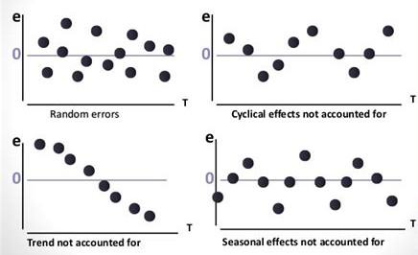
Residual Analysis

Slide 48
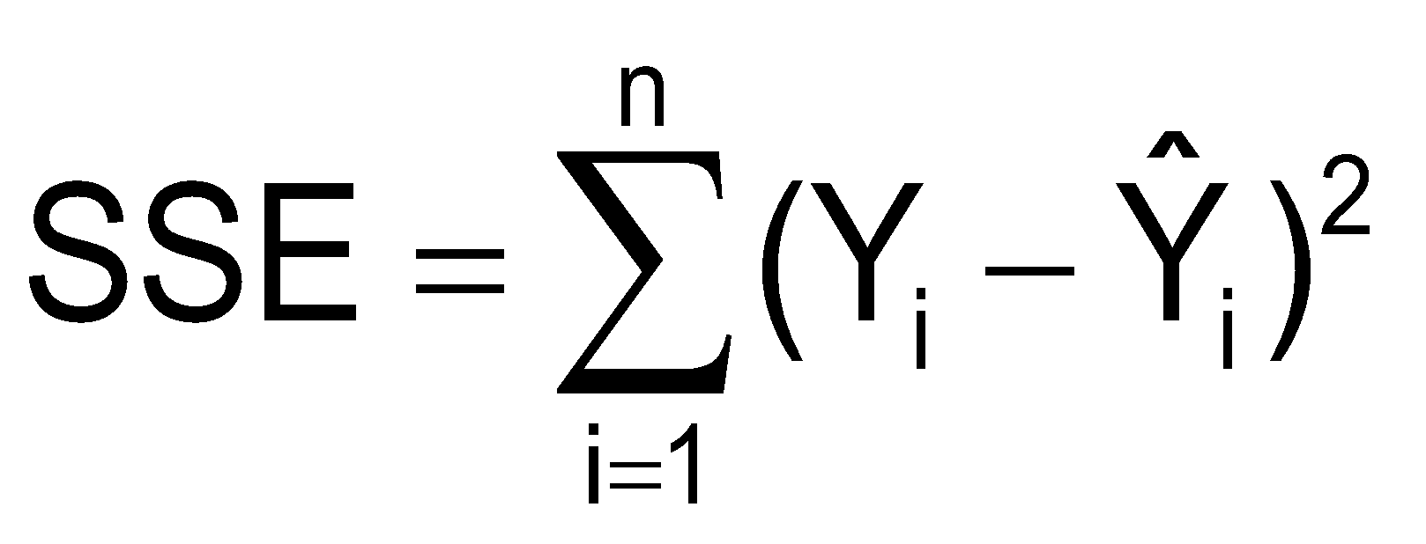
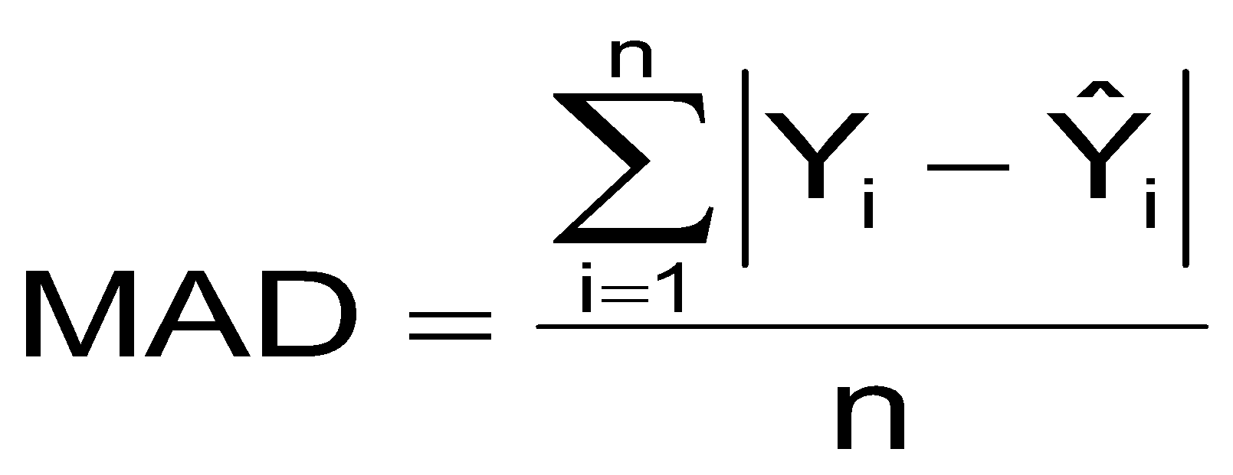
Measuring Errors
Choose the model that gives the smallest measuring errors
Sum of squared errors (SSE)
Sensitive to outliers
Mean Absolute Deviation (MAD)
Less sensitive to extreme observations

Slide 49
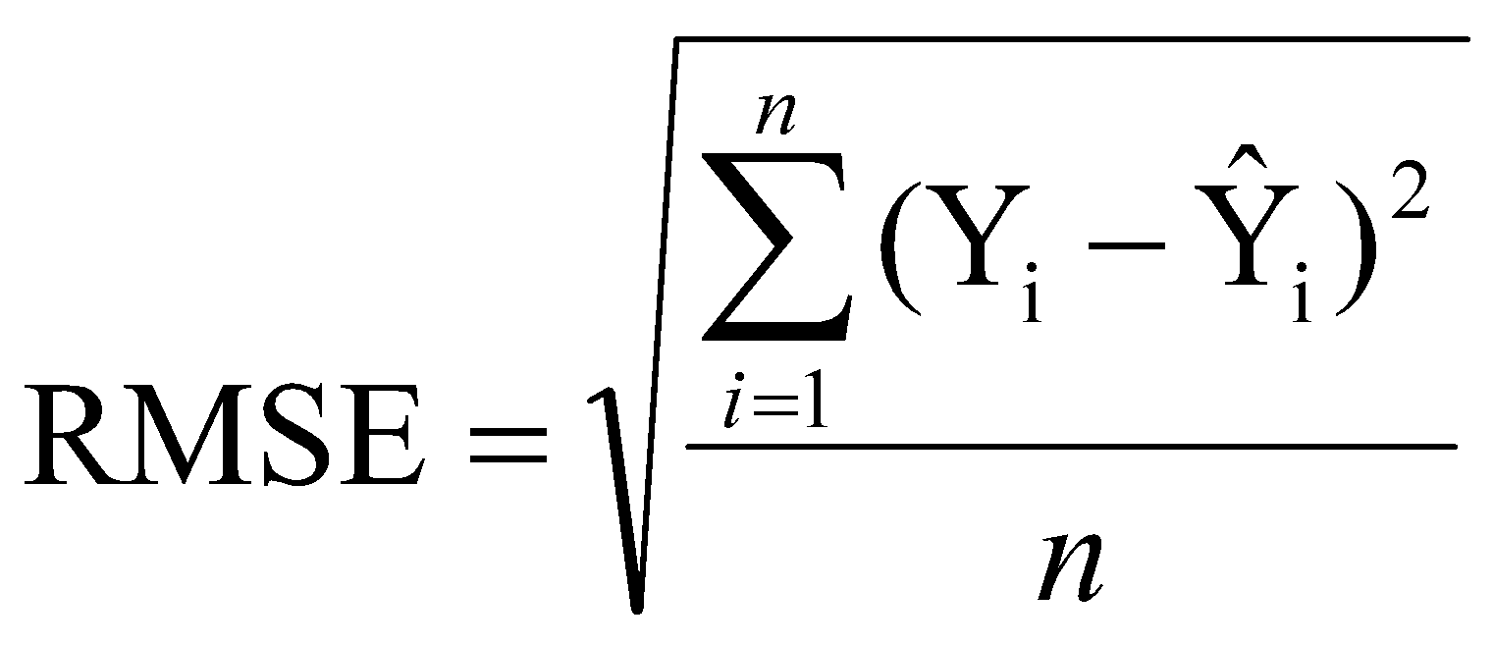
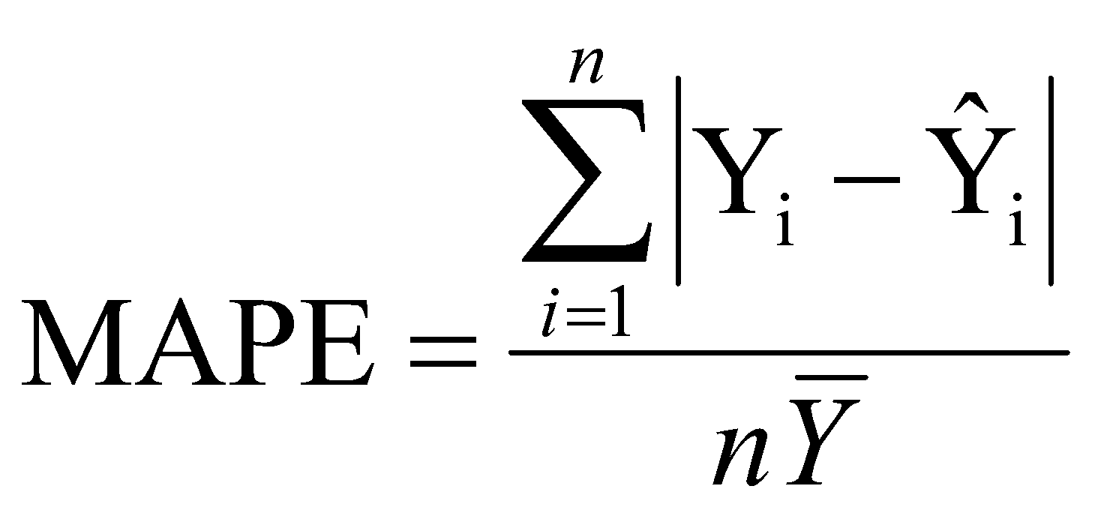
Measuring Errors
Root Mean Squared Error (RMSE)
Mean Absolute Percentage Error (MAPE)
Insensitive to the scale

Slide 50
Principle of Parsimony
Suppose two or more models provide a good fit for the data
Select the simplest model
Simplest model types:
Least-squares linear
Least-squares quadratic
1st order autoregressive
More complex types:
2nd and 3rd order autoregressive
Least-squares exponential

Slide 51
Three methods for Trend-Based Forecasting
Linear Trend Forecasting
Nonlinear Trend Forecasting
Exponential Trend Forecasting

Slide 52
Linear Trend Forecasting
Estimate a trend line using regression analysis
Use time (X) as the independent variable
y - Sales
β0 , β1 are coefficient
εt - Error term
Year | Time | Sales
1999 2000 2001 2002 2003 2004 | 0 1 2 3 4 5 | 20 40 30 50 70 65

Slide 53
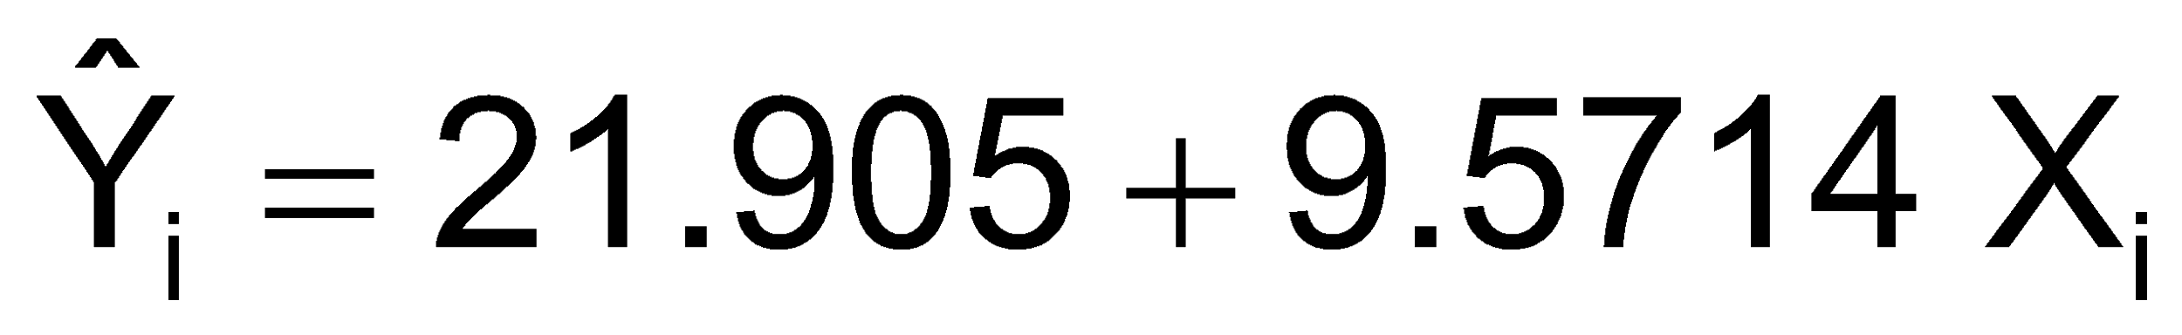
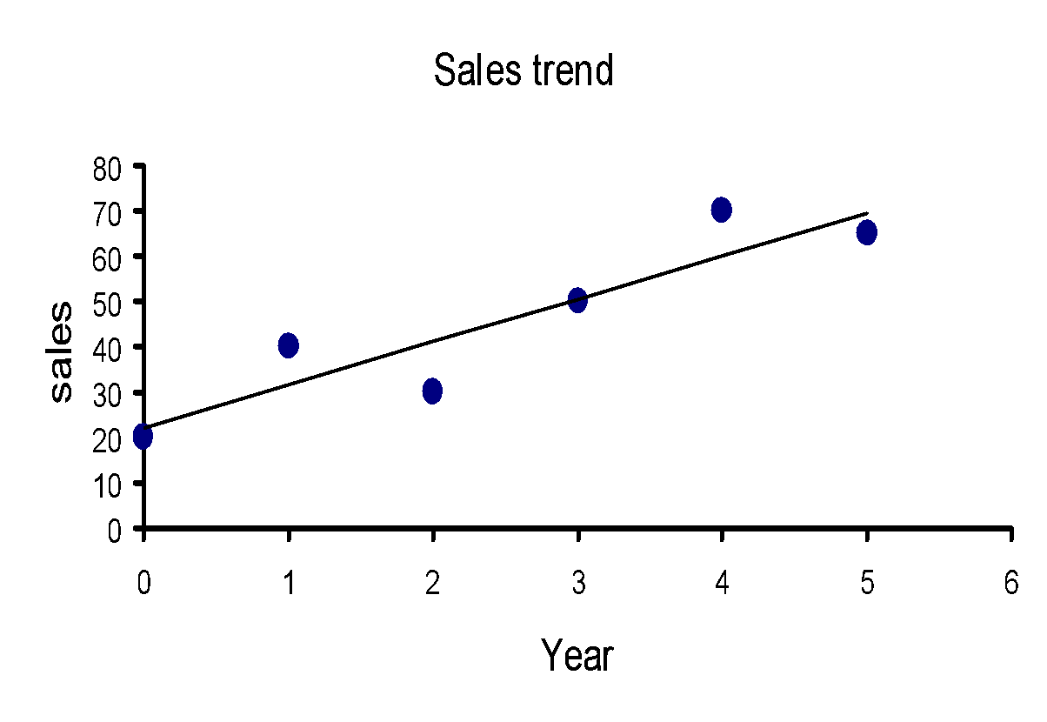
Linear Trend Forecasting
The linear trend forecasting equation is:
Year | Time | Sales
1999 2000 2001 2002 2003 2004 | 0 1 2 3 4 5 | 20 40 30 50 70 65

Slide 54
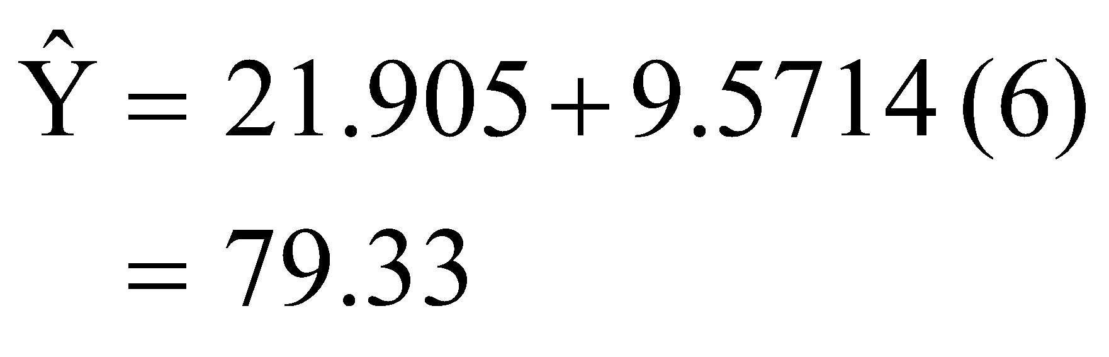
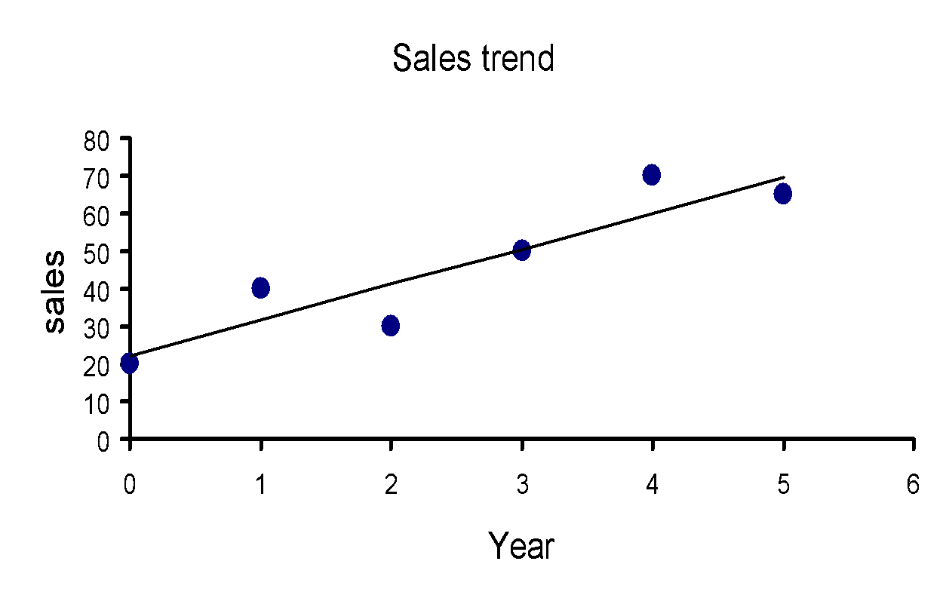
Linear Trend Forecasting
Forecast for time period 2005 :
Year | Time | Sales
1999 2000 2001 2002 2003 2004 2005 | 0 1 2 3 4 5 6 | 20 40 30 50 70 65 79.33

Slide 55

Non-linear Trend Forecasting
A nonlinear regression model can be used when the time series exhibits a nonlinear trend
Quadratic form is one type of a nonlinear model:
Compare adj. r2 and standard error to that of linear model to see if this is an improvement
Can try other functional forms to get best fit

Slide 56
Exponential Trend Model
Sometimes linear regression can be used with relationships which are not inherently linear, but can be made to be linear after a transformation. In particular, we consider the following exponential model:
After transforming into linear Model

Slide 57

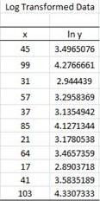
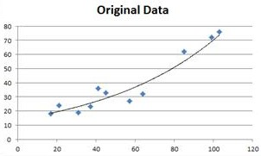
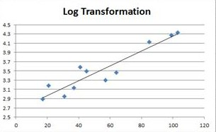
Exponential Trend Model

Slide 58
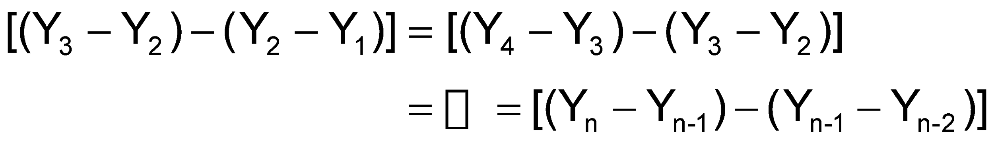
Trend Model Selection Using Differences
Use a linear trend model if the first differences are approximately constant
Use a quadratic trend model if the second differences are approximately constant

Slide 59
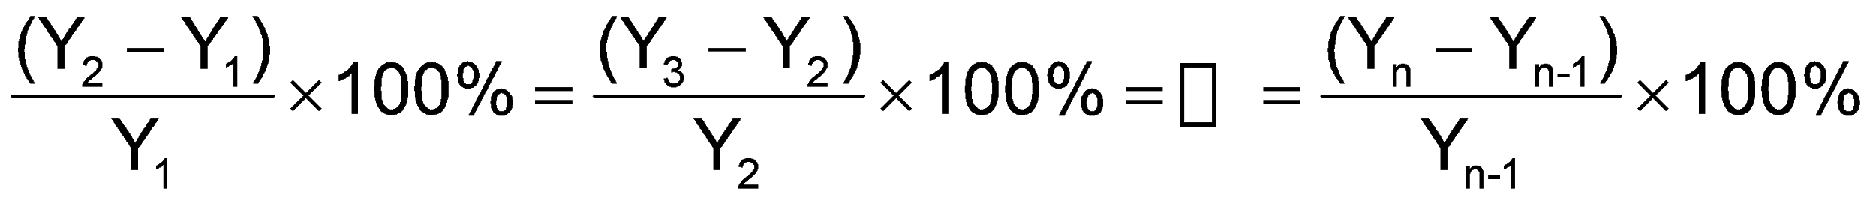
Trend Model Selection Using Differences
Use an exponential trend model if the percentage differences are approximately constant

Slide 60
Forecasting With Seasonal Data
Time series are often collected monthly or quarterly
These time series often contain a trend component, a seasonal component, and the irregular component
Suppose the seasonality is quarterly
Define three new dummy variables for quarters:
Q₁ = 1 if first quarter, 0 otherwise
Q₂ = 1 if second quarter, 0 otherwise
Q₃ = 1 if third quarter, 0 otherwise
(Quarter 4 is the default if Q₁ = Q₂ = Q₃ = 0)

Slide 61
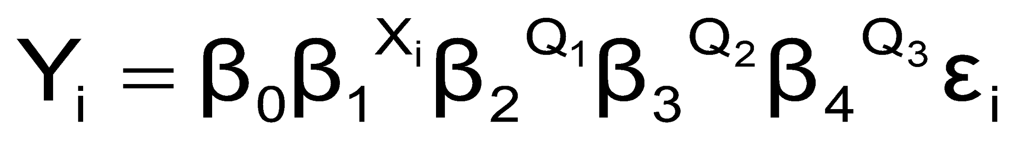
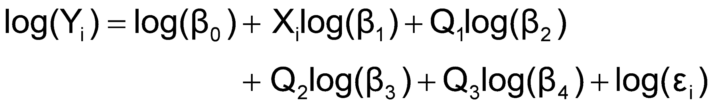
Exponential Model with Quarterly data
(β₁–1)x100% is the quarterly compound growth rate
β_{i} provides the multiplier for the i^{th} quarter relative to the 4th quarter (i = 2, 3, 4)
Transform to linear form:

Slide 62
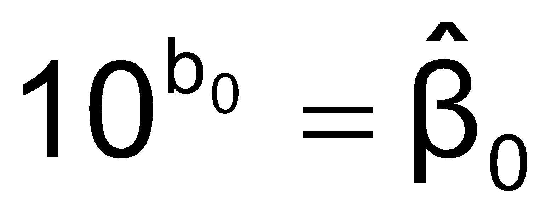
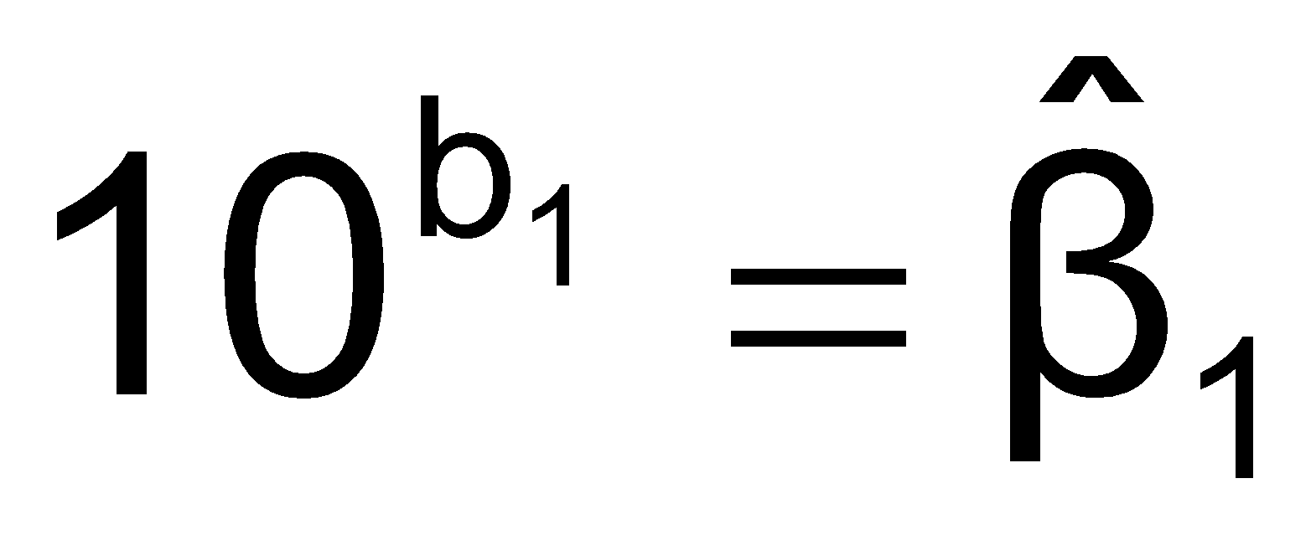
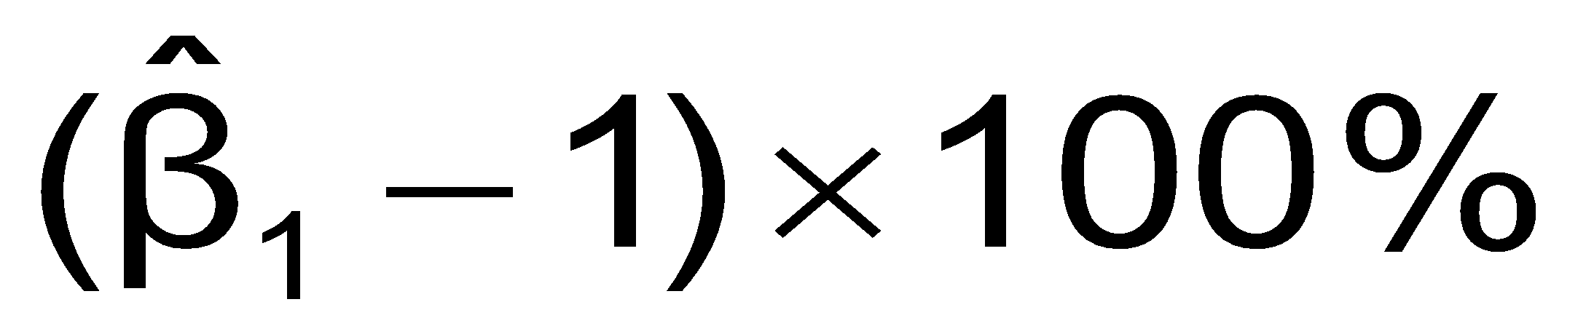
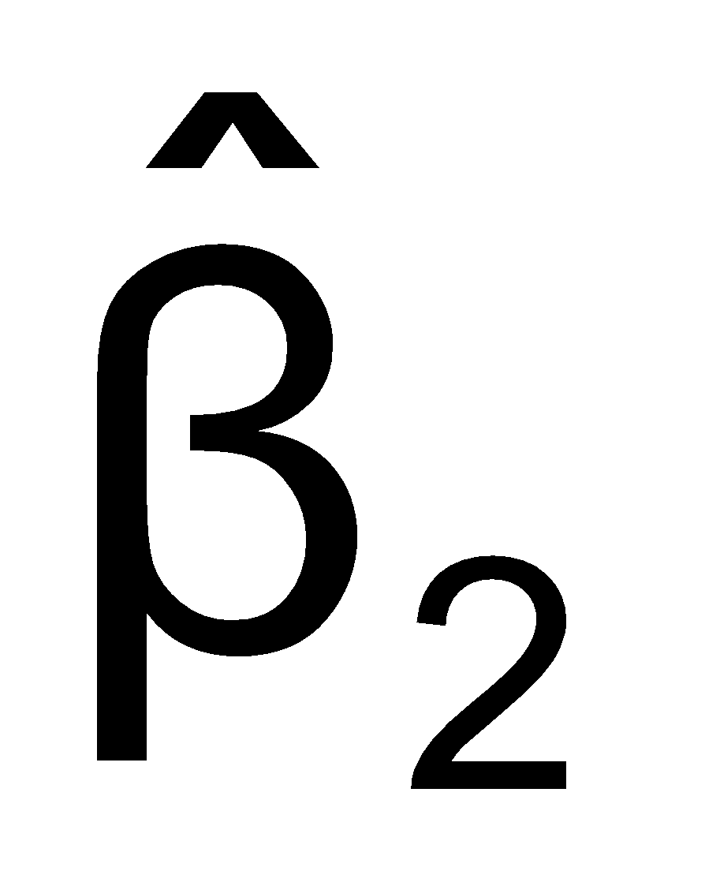
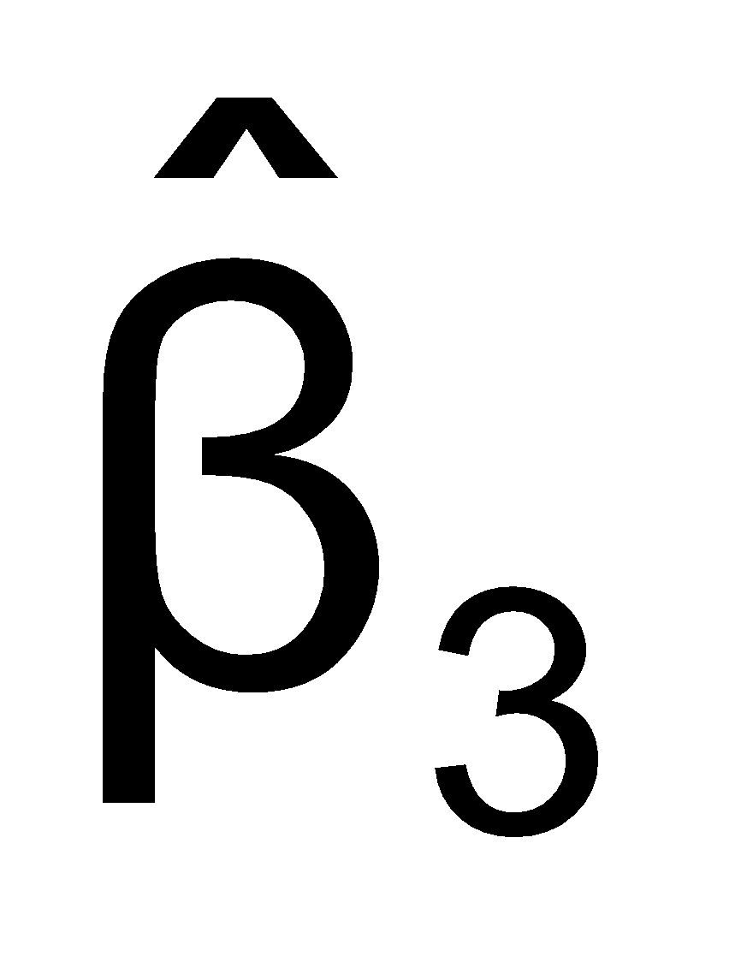
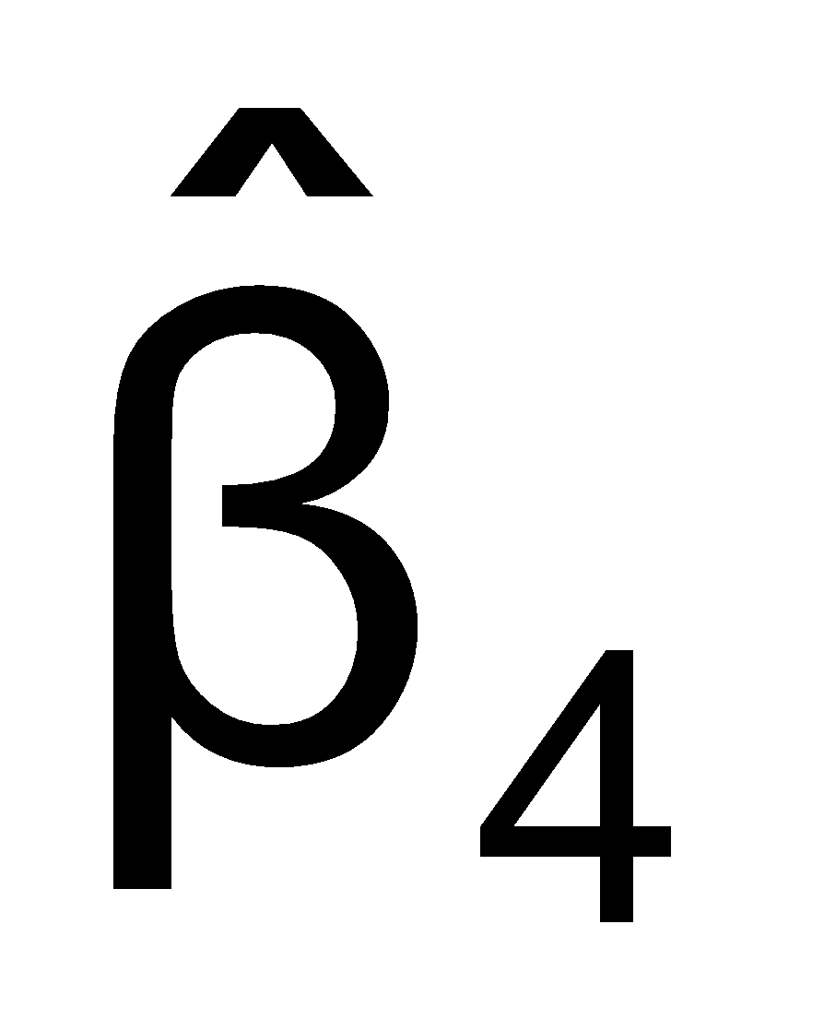
Estimating the Quarterly Model
Exponential forecasting equation:
where b₀ = estimate of log(β₀), so
b₁ = estimate of log(β₁), so
etc…
Interpretation:
= Estimated quarterly compound growth rate (in %)
= Estimated multiplier for first quarter relative to fourth quarter
= Estimated multiplier for second quarter relative to fourth quarter
= Estimated multiplier for third quarter relative to fourth quarter

Slide 63
Quarterly Model Example
Suppose the forecasting equation is:
b₀ = 3.43
b₁ = .017, so
b₂ = -.082, so
b₃ = -.073, so
b₄ = .022, so

Slide 64
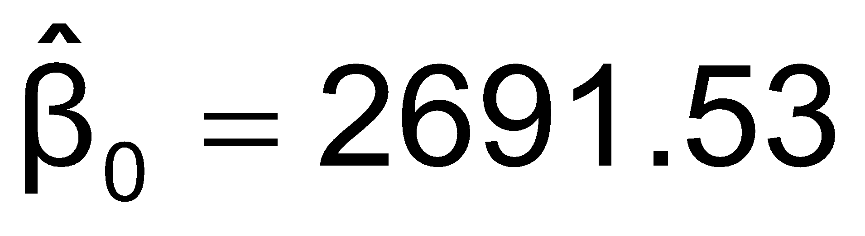
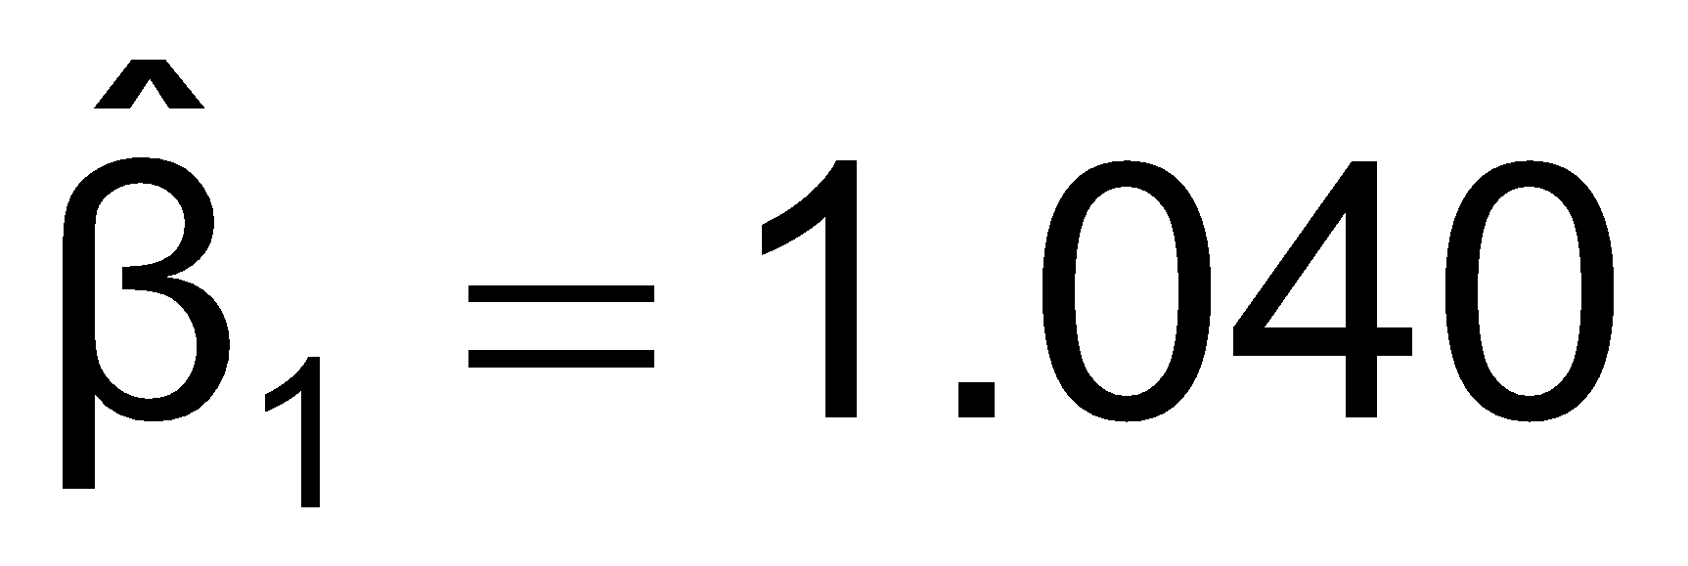
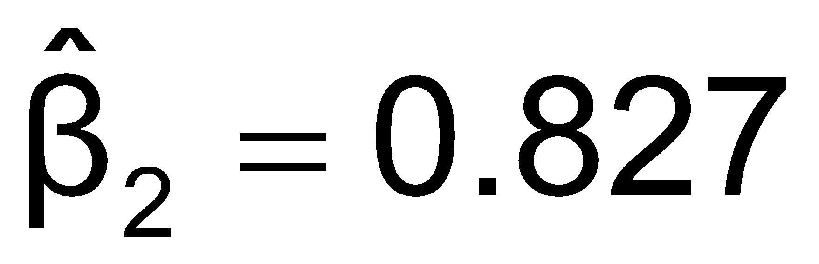
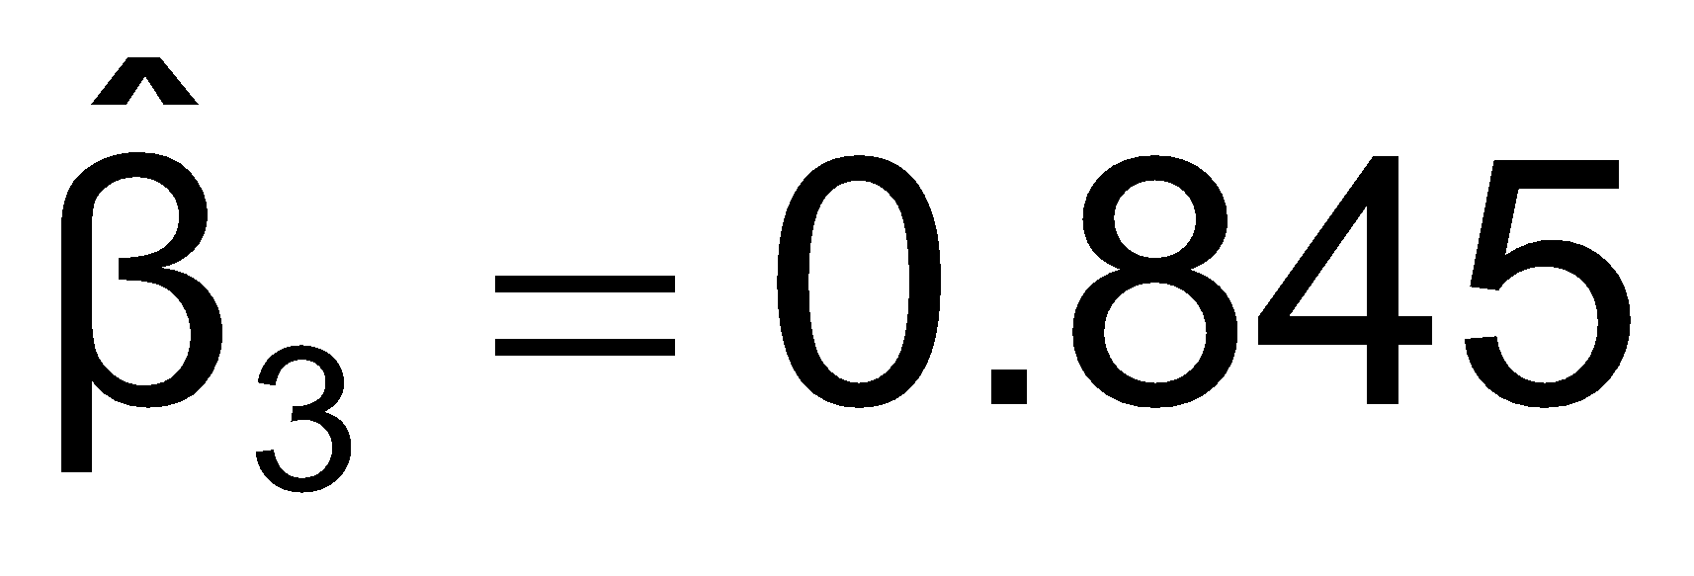
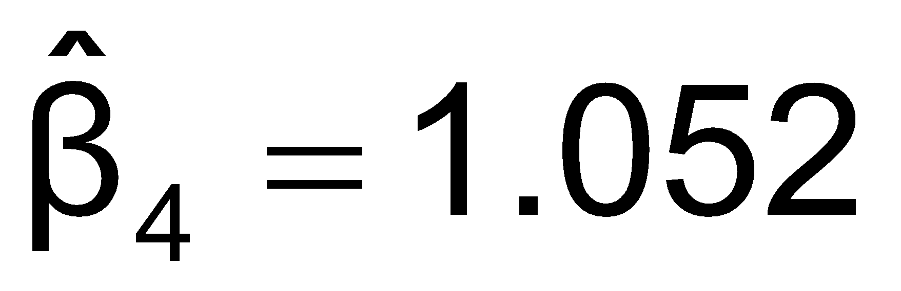
Quarterly Model Interpretation
Value
Interpretation
Unadjusted trend value for first quarter of first year
4.0% = estimated quarterly compound growth rate
Average sales in Q₁ are 82.7% of average 4th quarter sales, after adjusting for the 4% quarterly growth rate
Average sales in Q₂ are 84.5% of average 4th quarter sales, after adjusting for the 4% quarterly growth rate
Average sales in Q₃ are 105.2% of average 4th quarter sales, after adjusting for the 4% quarterly growth rate

Slide 65
Importance of forecasting
Governments forecast unemployment rates, interest rates and expected revenues from income taxes for policy purposes
Marketing executives forecast demand, sales, and consumer preferences for strategic planning
College administrators forecast enrollments to plan for facilities and for faculty recruitment
Retail stores forecast demand to control inventory levels, hire employees and provide training

Slide 66

Time series are often collected monthly or quarterly. These time series often contain a trend component, a seasonal component, and the irregular component

Slide 67
Time Series Models

Slide 68
Autoregressive Modeling
Autoregression is a time series model that uses observations from previous time steps as input to a regression equation to predict the value at the next time step.
It is a very simple idea that can result in accurate forecasts on a range of time series problems.
Takes advantage of autocorrelation
1st order - correlation between consecutive values
2nd order - correlation between values 2 periods apart

Slide 69
Autoregressive Modeling
Let Xt (t = 1,2,3,.....,n) be time series
A autoregressive model of order p to represent that series is:
Where
𝛾, εt are fixed parameters
φ are random variables that have
Mean zero
Constant variance
Are not correlated with one another

Slide 70
Steps to build a AR Model
Choose p (Note that df = n – 2p – 1)
Form a series of “lagged predictor” variables
Y_{i-1} , Y_{i-2} , … ,Y_{i-p}
Use Excel or Minitab to run regression model using all p variables
Test significance of A_{p}
If null hypothesis rejected, this model is selected
If null hypothesis not rejected, decrease p by 1 and repeat

Slide 71
Autoregressive Model Example
The Office Concept Corp. has acquired a number of office units (in thousands of square feet) over the last eight years. Develop the second order Autoregressive model
Year | Unit
1997 | 4
1998 | 3
1999 | 2
2000 | 3
2001 | 2
2002 | 2
2003 | 4
2004 | 6

Slide 72
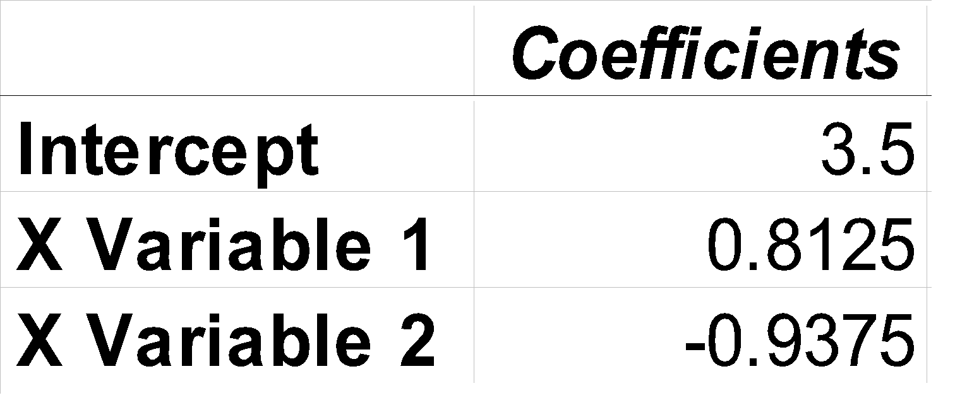

Autoregressive Model Example
Year | Yj | Yj-1 | Yj-2
1997 | 4 | -- | --
1998 | 3 | 4 | --
1999 | 2 | 3 | 4
2000 | 3 | 2 | 3
2001 | 2 | 3 | 2
2002 | 2 | 2 | 3
2003 | 4 | 2 | 2
2004 | 6 | 4 | 2
Develop the 2nd order table
Use Excel or Minitab to estimate a regression model
Output

Slide 73

Autoregressive Model Example
Use the second-order equation to forecast number of units for 2005:

Slide 74
Moving Averaging Modeling
A moving average term in a time series model is a past error (multiplied by a coefficient).
The 1st order moving average model, denoted by MA(1) is:
xt=μ+wt+θ1wt−1
The 2nd order moving average model, denoted by MA(2) is:
xt=μ+wt+θ1wt−1+θ2wt−2
The qth order moving average model, denoted by MA(q) is:
xt=μ+wt+θ1wt−1+θ2wt−2+⋯+θqwt−q

Slide 75
Partial Autocorrelation Function (PACF)
A partial correlation is a conditional correlation between two variables
For instance, consider a regression context in which y is the response variable and x1, x2, and x3 are predictor variables. The partial correlation between y and x3 is the correlation between the variables determined taking into account how both y and x3 are related to x1 and x2.
The f _{kk} is a partial autocorrelation of order k is denoted as
f _{kk} = Correlation (y_{t}, y_{(t-k)} , y_{(t-1)} ,..., y_{(t-k+1)} )

Slide 76

Autoregressive Moving Average model (ARMA)
The ARMA(p,q) model is a linear combination of two linear models and thus is itself still linear
ARMA models provide a parsimonious description of a (weakly) stationary stochastic process in terms of two polynomials, one for the autoregression (AR) and the second for the moving average (MA)

Slide 77


Simulate ARMA(1,1) process
ARMA process of order 1 in both its moving average and autoregressive
We will simulate the following ARMA process:

Slide 78


The ACF and PACF plots

Slide 79

Simulate ARMA(2,2) process
ARMA process of order 2 in both its moving average and autoregressive
We will simulate the following ARMA process:

Slide 80


The ACF and PACF plots

Slide 81
ARIMA Model
Autoregressive Integrated Moving Average (ARIMA) models is actually a class of models that ‘explains’ a given time series based on its own past values
ARIMA models are defined for stationary time series
In ARIMA
AR - Autoregressive
MA - Moving Average
I - Integration

Slide 82
ARIMA Model
An ARIMA model is characterized by 3 terms: p, d, q
The value of d is the minimum number of differencing needed to make the series stationary if the time series is already stationary, then d = 0
‘p’ is the order of the ‘Autoregressive’ (AR) term, it refers to the number of lags of y to be used as predictors
And ‘q’ is the order of the ‘Moving Average’ (MA) term, it refers to the number of lagged forecast errors that should go into the ARIMA Model.

Slide 83

How to find the order of the AR term (p)?
Any autocorrelation in a stationarized series can be rectified by adding enough AR terms. So, we initially take the order of AR term to be equal to as many lags that crosses the significance limit in the PACF plot

Slide 84

How to find the order of the MA term (q)?
An MA term is technically, the error of the lagged forecast
We can look at the ACF plot for the number of MA terms
The ACF tells how many MA terms are required to remove any autocorrelation in the stationarized series

Slide 85
How to find the order of differencing (d)?
The purpose of differencing it to make the time series stationary.
The right order of differencing is the minimum differencing required to get a near-stationary series which roams around a defined mean and the ACF plot reaches to zero fairly quick.
If the autocorrelations are positive for many number of lags (10 or more), then the series needs further differencing
If the lag 1 autocorrelation itself is too negative, then the series is probably over-differenced

Slide 86
How to find the order of differencing (d)?
However, in the presence of an ARIMA(p,d,0) process:
the ACF is exponentially decaying or sinusoidal
the PACF has a significant spike at lag p but none after
Similarly, in the presence of an ARIMA(0,d,q) process:
the PACF is exponentially decaying or sinusoidal
the ACF has a significant spike at lag q but none after

Slide 87
General Modelling Procedure
Plot the data and identify unusual observations. Understand the pattern of the data
Apply a transformation or differencing to remove the trend and stabilize the variance
Test for stationarity. If the series is not stationary, apply another transformation or differencing
Plot the ACF and PACF to maybe estimate the order of the MA or AR process
Try different combinations of orders and select the model with the lowest AIC.
Check the residuals and make sure that they look like white noise. Apply the Ljung-Box test to make sure
Calculate forecasts

Slide 88

Invertibility of MA models: An MA model is said to be invertible if it is algebraically equivalent to a converging infinite order AR model. By converging, we mean that the AR coefficients decrease to 0 as we move back in time.

Slide 89
To build a model on multivariate time series, Vector Autoregression (VAR) is used
In a VAR model, each variable is a linear function of the past values of itself and the past values of all the other variables

Slide 90





AWARDS:
Learn more:
https://imarticus.org/corporate/
Email us:
info@imarticus.com
Connect with us:
www.linkedin.com/company/imarticuslearning
ACCREDITED TRAINING PARTNER:
Watch us:
www.youtube.com/ImarticusLearninginstitute
Visit us:
Mumbai | Thane | Pune | Bangalore | Delhi - NCR | Hyderabad | Chennai | Coimbatore

